Slide 1

Relativistic Momentum and Energy

Slide 2
Key objectives
Relativistic momentum increases at high relative speed and prevents an object from reaching the speed of light
Observations of objects travelling at very high speeds cannot be explained by Newtonian physics. These include the dilated half-life of high-speed muons created in the upper atmosphere, and the momentum of high-speed particles in particle accelerators.
The concept of mass-energy equivalence emerged from the special theory of relativity and explains the source of the energy produced in nuclear reactions

Slide 3

Equations
Relativistic Momentum:
$$p_{v}=\frac{mv}{\sqrt{1−\frac{v^{2}}{c^{2}}}}$$
Mass energy equivalence:
$$E=\frac{mc^{2}}{\sqrt{1−\frac{v^{2}}{c^{2}}}}$$

Slide 4
Text References
Step Up 4.5

Slide 5
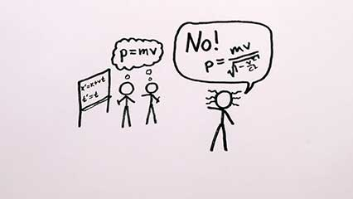
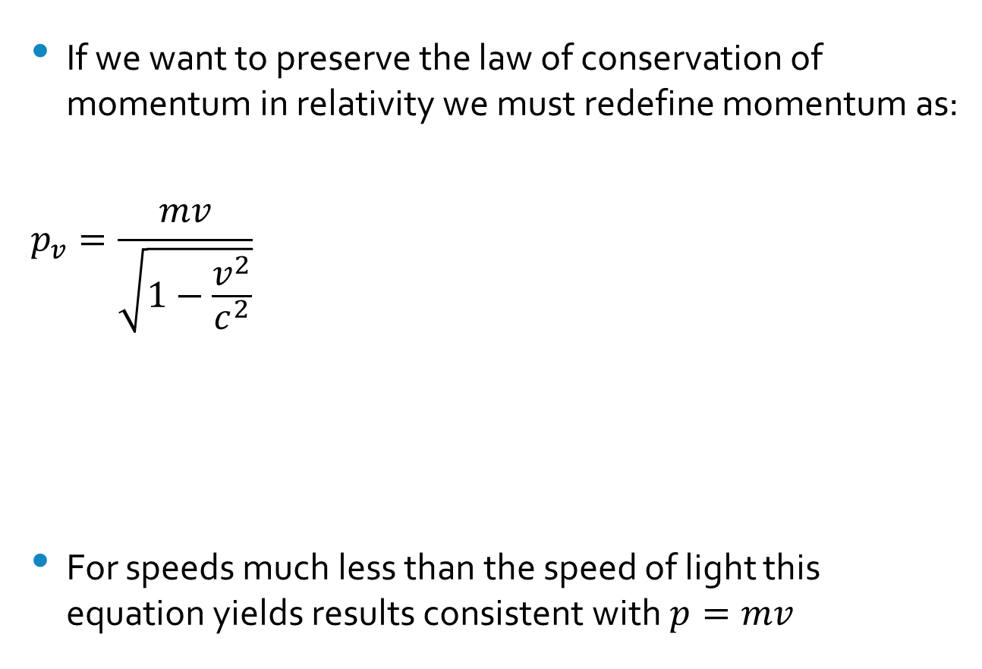

Relativistic momentum
If we want to preserve the law of conservation of momentum in relativity we must redefine momentum as:
$$p_{v}=\frac{mv}{\sqrt{1−\frac{v^{2}}{c^{2}}}}$$
For speeds much less than the speed of light this equation yields results consistent with $p=mv$
Note: m is the rest mass, this is often represented by $m_{o}$

Slide 6
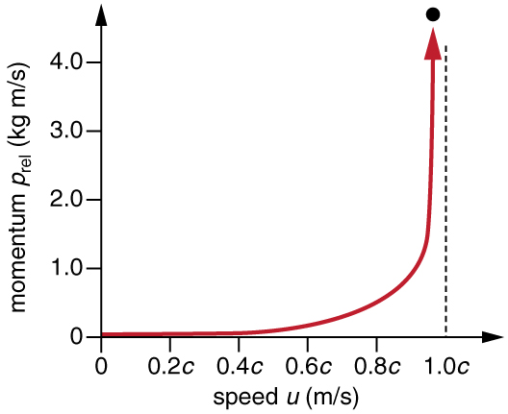
The graph of classical momentum is linear, and does not respond to the limiting velocity of c.
At low velocities, the graph of momentum vs v/c follows the linear trend but as it approaches the limiting value of 1 then it tends to infinity.

Slide 7
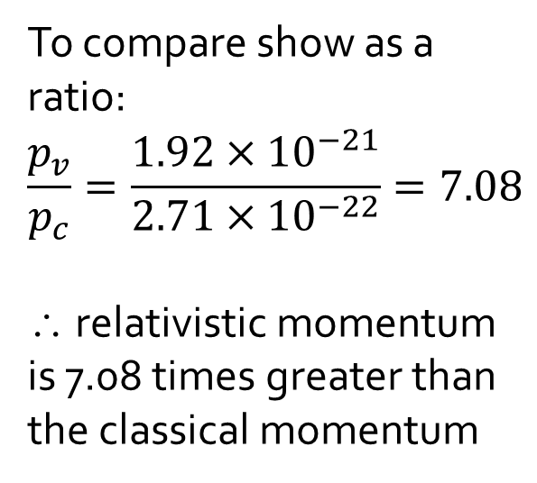
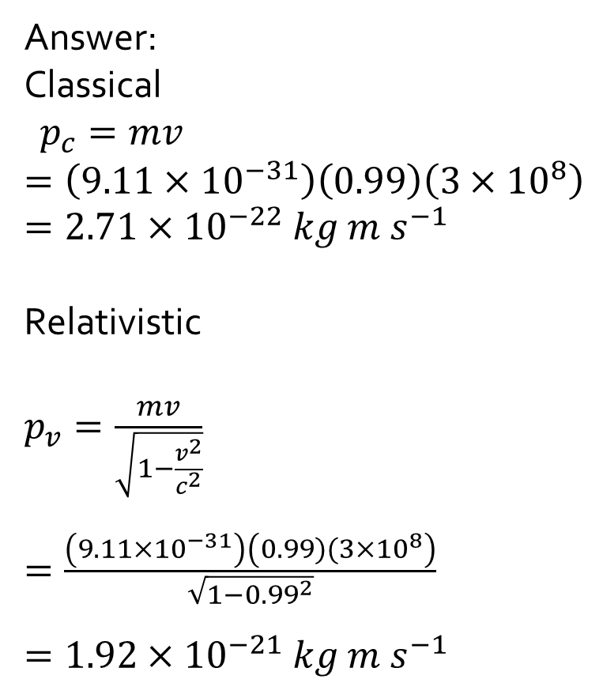
Question: Compare the relativistic and classical momentum of an electron moving at 0.99 c
Answer:
Classical
$p_{c}=mv$
$=\left(9.11×{10}^{−31}\right)\left(0.99\right)\left(3×{10}^{8}\right)$
$=2.71×{10}^{−22} kg m s^{−1}$
Relativistic
$p_{v}=\frac{mv}{\sqrt{1−\frac{v^{2}}{c^{2}}}}$
$=\frac{\left(9.11×{10}^{−31}\right)\left(0.99)(3×{10}^{8}\right)}{\sqrt{1−{0.99}^{2}}}$
$=1.92×{10}^{−21} kg m s^{−1}$
To compare show as a ratio:
$$\frac{p_{v}}{p_{c}}=\frac{1.92×{10}^{−21}}{2.71×{10}^{−22}}=7.08$$
∴ relativistic momentum is 7.08 times greater than the classical momentum

Slide 8
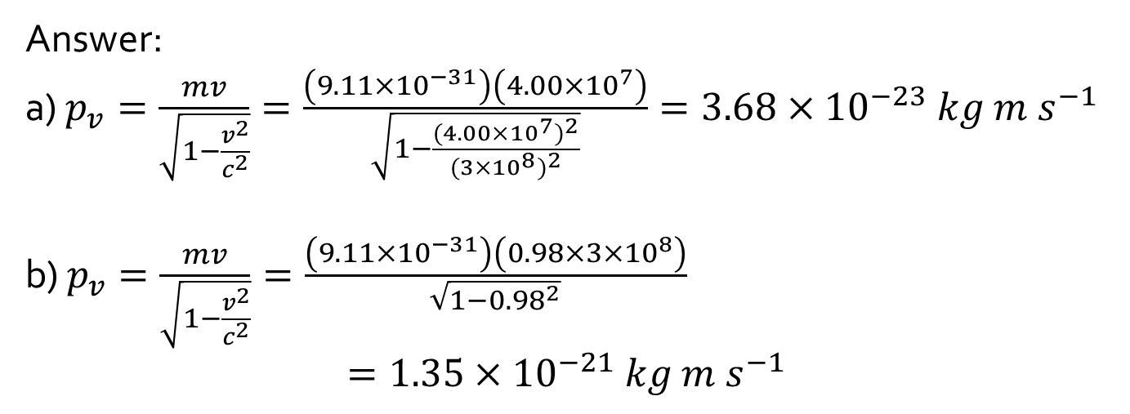
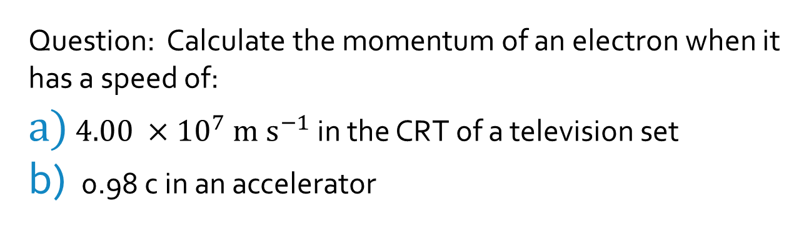
Question: Calculate the momentum of an electron when it has a speed of:
$4.00 ×{10}^{7} m s^{−1}$ in the CRT of a television set
0.98 c in an accelerator
Answer:
a) $p_{v}=\frac{mv}{\sqrt{1−\frac{v^{2}}{c^{2}}}}=\frac{\left(9.11×{10}^{−31}\right)\left(4.00×{10}^{7}\right)}{\sqrt{1−\frac{{(4.00×{10}^{7})}^{2}}{{(3×{10}^{8})}^{2}}}}=3.68×{10}^{−23} kg m s^{−1}$
b) $p_{v}=\frac{mv}{\sqrt{1−\frac{v^{2}}{c^{2}}}}=\frac{\left(9.11×{10}^{−31}\right)\left(0.98×3×{10}^{8}\right)}{\sqrt{1−{0.98}^{2}}}$
$$=1.35×{10}^{−21} kg m s^{−1}$$

Slide 9
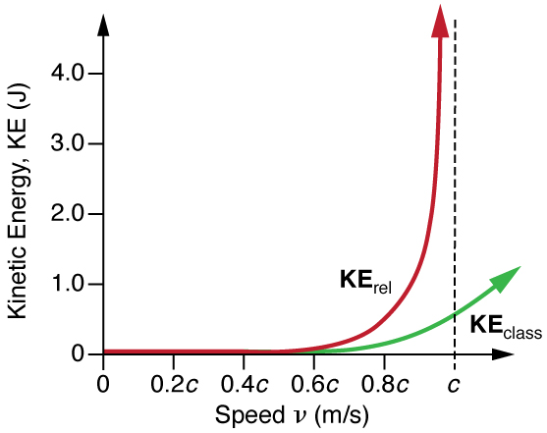
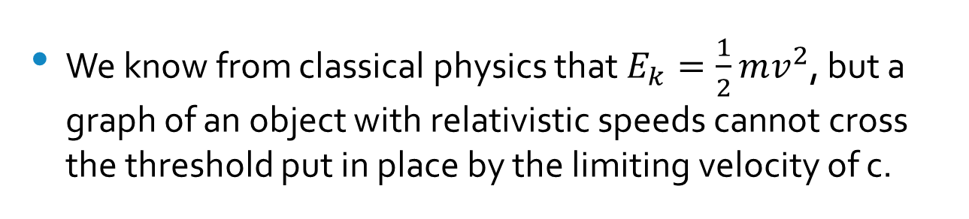
Relativistic Energy
We know from classical physics that $E_{k}=\frac{1}{2}mv^{2}$, but a graph of an object with relativistic speeds cannot cross the threshold put in place by the limiting velocity of c.

Slide 10
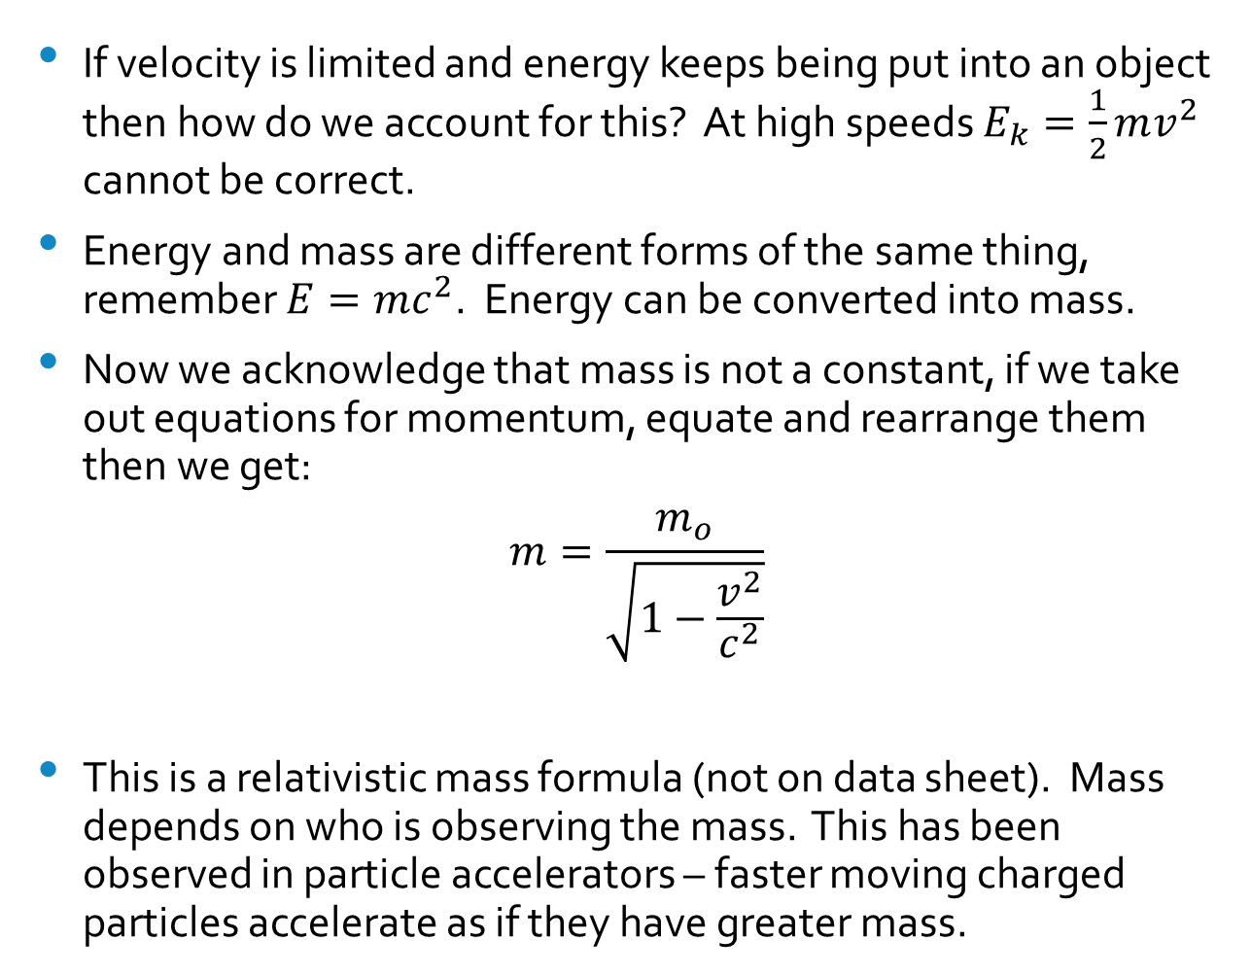
If velocity is limited and energy keeps being put into an object then how do we account for this? At high speeds $E_{k}=\frac{1}{2}mv^{2}$ cannot be correct.
Energy and mass are different forms of the same thing, remember $E=mc^{2}$. Energy can be converted into mass.
Now we acknowledge that mass is not a constant, if we take out equations for momentum, equate and rearrange them then we get:
$$m=\frac{m_{o}}{\sqrt{1−\frac{v^{2}}{c^{2}}}}$$
This is a relativistic mass formula (not on data sheet). Mass depends on who is observing the mass. This has been observed in particle accelerators – faster moving charged particles accelerate as if they have greater mass.

Slide 11
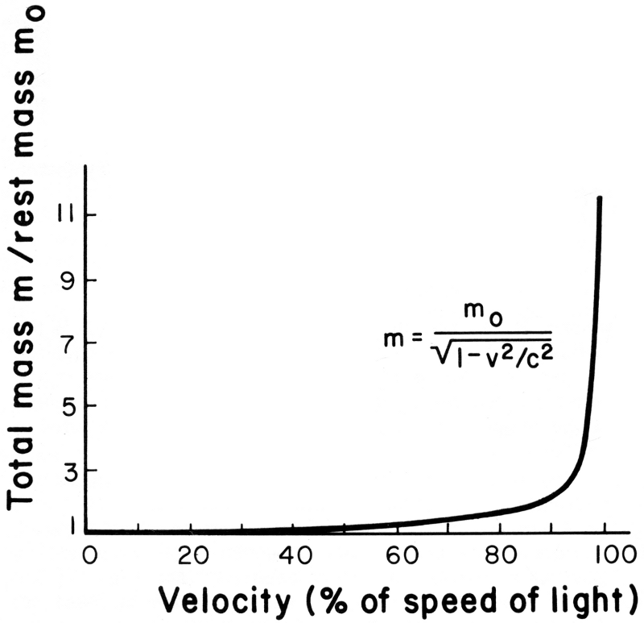
The more energy put into an object as it approaches the speed of light, the higher the mass of the object will be.

Slide 12
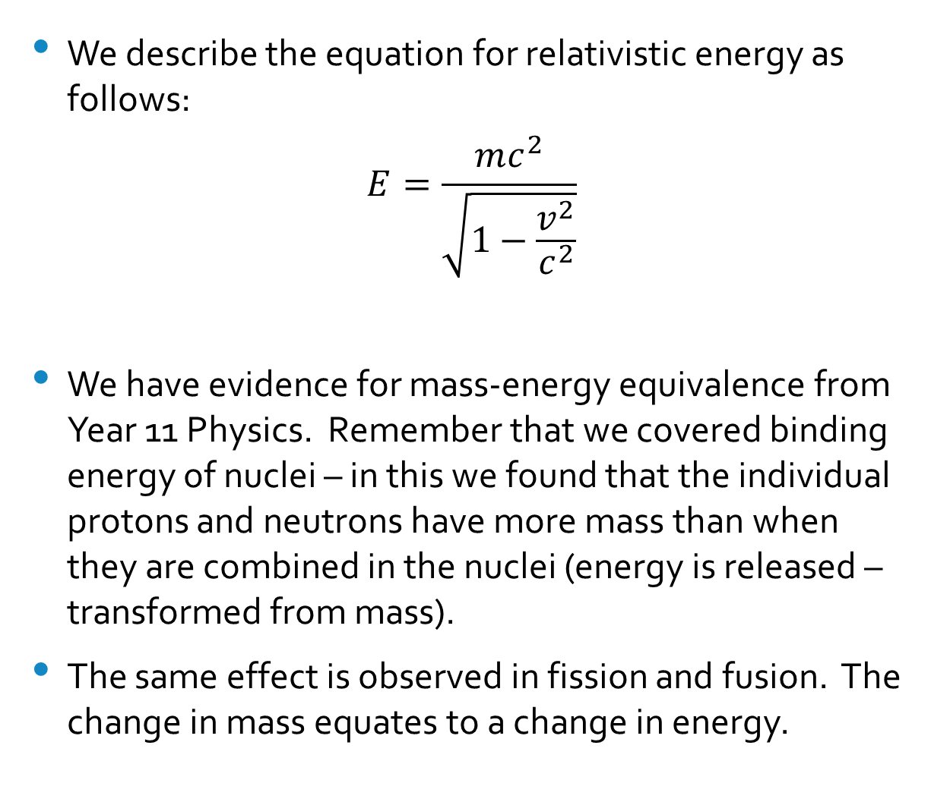
We describe the equation for relativistic energy as follows:
$$E=\frac{mc^{2}}{\sqrt{1−\frac{v^{2}}{c^{2}}}}$$
We have evidence for mass-energy equivalence from Year 11 Physics. Remember that we covered binding energy of nuclei – in this we found that the individual protons and neutrons have more mass than when they are combined in the nuclei (energy is released – transformed from mass).
The same effect is observed in fission and fusion. The change in mass equates to a change in energy.

Slide 13
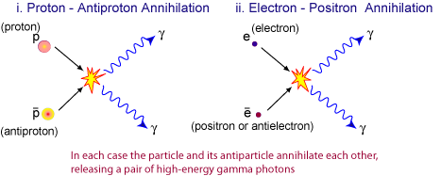
Annihilation of matter and antimatter also produces energy from mass.
The particles have energy determined by their mass and kinetic energy.
The masses ‘disappear’, but conservation of energy holds as the mass turns into energy.

Slide 14
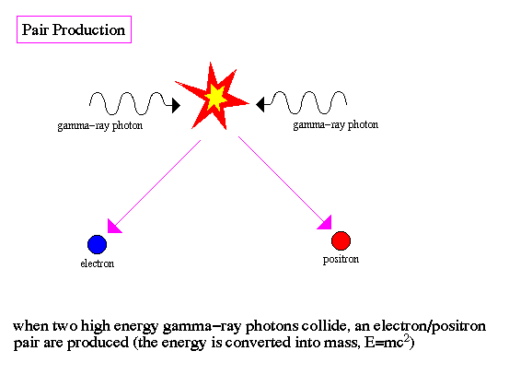
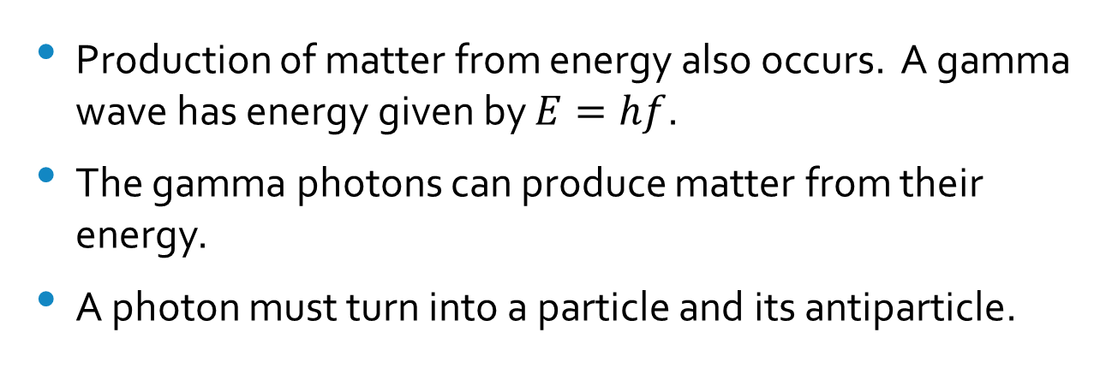
Production of matter from energy also occurs. A gamma wave has energy given by $E=hf$.
The gamma photons can produce matter from their energy.
A photon must turn into a particle and its antiparticle.

Slide 15
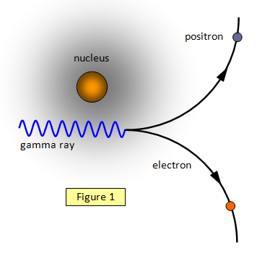
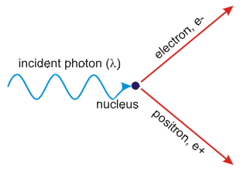

Slide 16
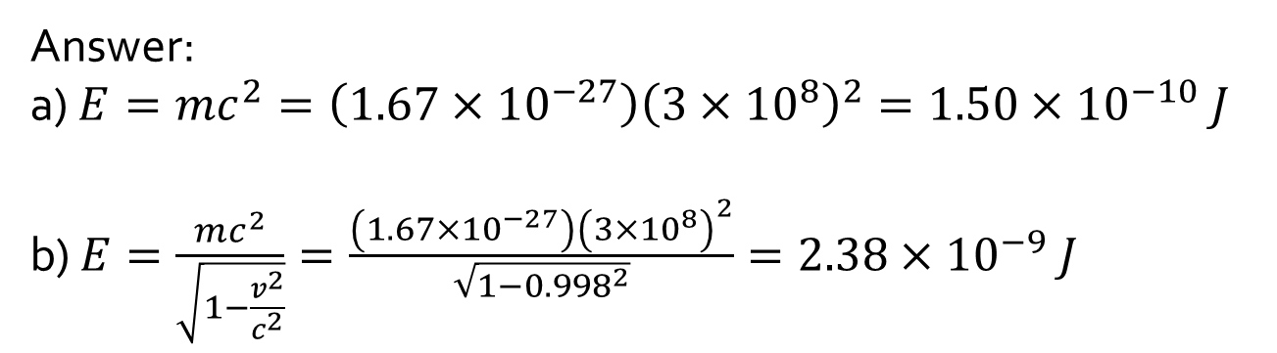
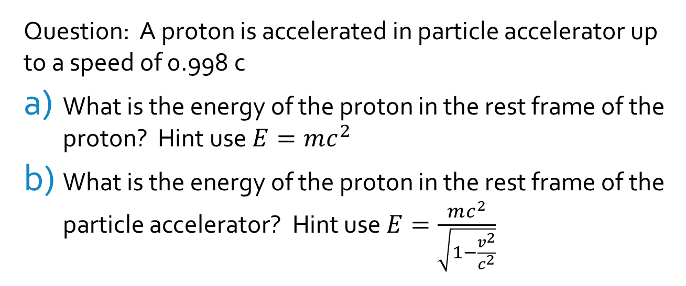
Question: A proton is accelerated in particle accelerator up to a speed of 0.998 c
What is the energy of the proton in the rest frame of the proton? Hint use $E=mc^{2}$
What is the energy of the proton in the rest frame of the particle accelerator? Hint use $E=\frac{mc^{2}}{\sqrt{1−\frac{v^{2}}{c^{2}}}}$
Answer:
a) $E=mc^{2}=\left(1.67×{10}^{−27}\right){\left({3×10}^{8}\right)}^{2}=1.50×{10}^{−10} J$
b) $E=\frac{mc^{2}}{\sqrt{1−\frac{v^{2}}{c^{2}}}}=\frac{\left(1.67×{10}^{−27}\right){\left(3×{10}^{8}\right)}^{2}}{\sqrt{1−{0.998}^{2}}}=2.38×{10}^{−9} J$

